Slide 1
Digital Photomontage
Liliana
Interactive Digital Photomontage, Aseem Agarwala, et al.

Slide 2
Difinition
Combining parts of a set of photographs into a single composite image
To express greater detail

Slide 3
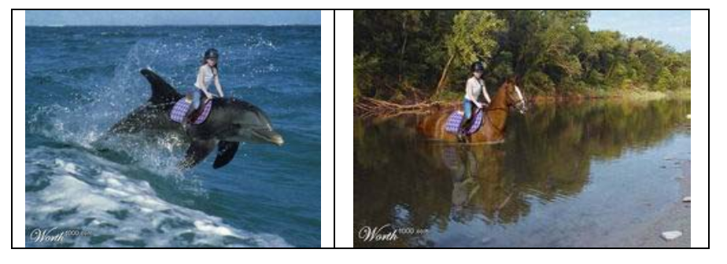
Photomontage image as art (before digital era)

Slide 4
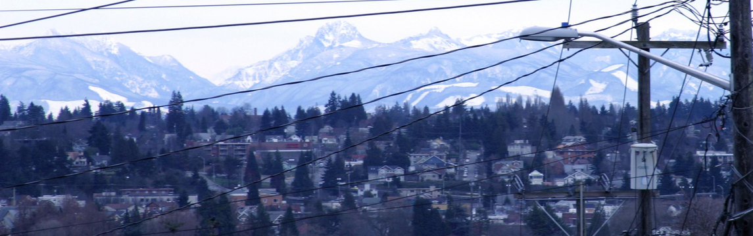
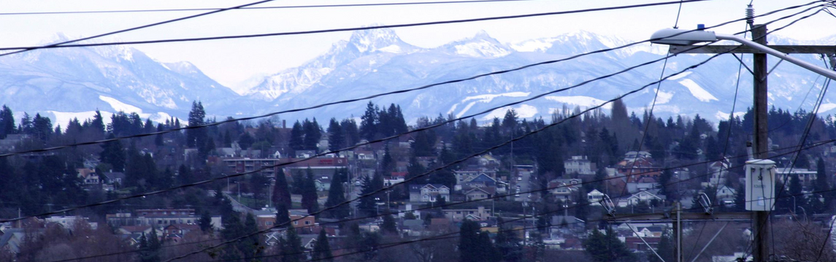
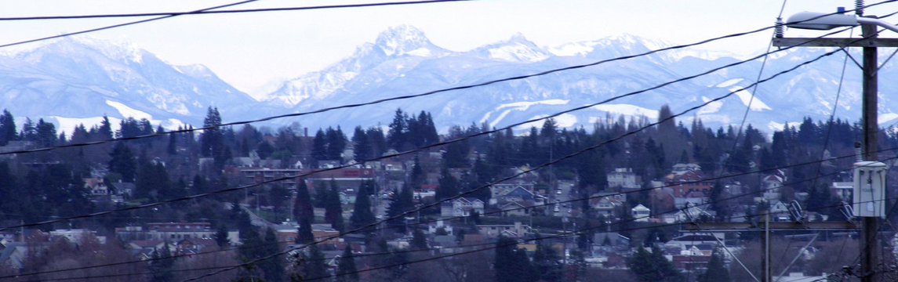
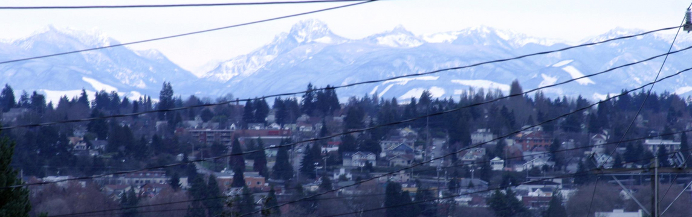
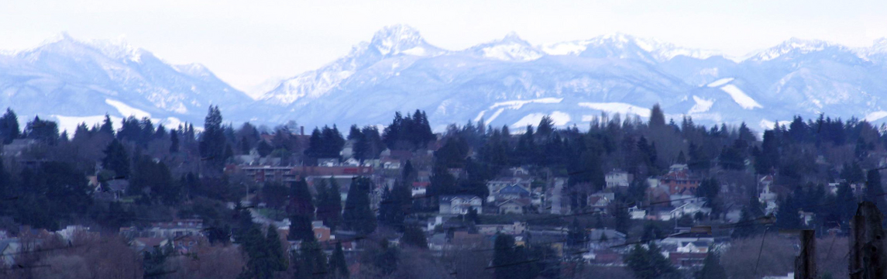
Digital photomontage

Slide 5
Digital photomontage can do....
Selective composites
Extended depth of field
Relighting
Straboscopic (vizualisation of movement)
Time-lapse mosaics
Panoramic stitching
Clean-plate production (remove transient object, ex:people)

Slide 6
Operations
Image splicing
to create a composite that satisfies the image and
seam objectives specified by the user
- Grab-cut optimization (Aseem Agarwala et al)
- Support Vector Machine (Tian-Tsong Ng and Shih-Fu Chang)
Gradient-domain fusion (Poisson equation)
to gain a seamless composite image

Slide 7
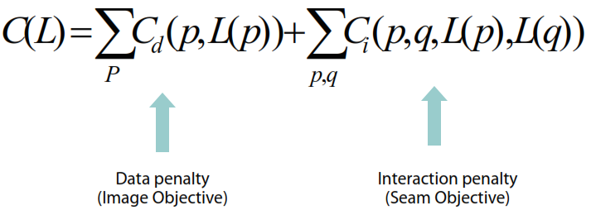
Grab-Cut optimozation
Suppose there are n source image, S1,...,Sn. To form a composite, user choose a source image Si for each pixel. Mapping between pixels and source image is labeling <L(p)>
Uses “alpha expansion” algorithm, to minimize cost function below:

Slide 8
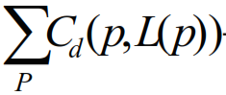
~ image objective ~
Designated Color
Min/Max Luminance
Min/Max Likelihood
Eraser
Min/Max Difference
Designated Image
Min/Max Contrast

Slide 9
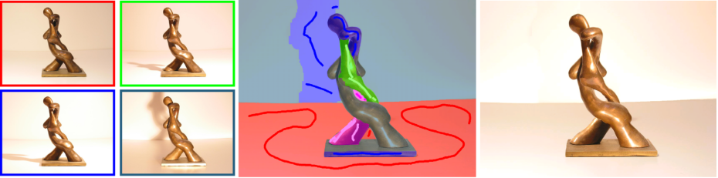
Designated color (most or least similar)
Specify a target color and find source images that have similar or different colors.
Cost function given by: Euclidean distance in RGB space.

Slide 10
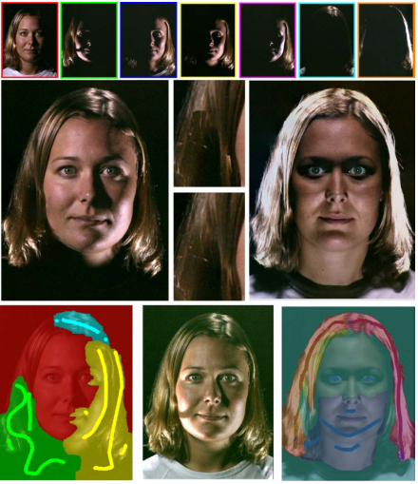
Max/ min luminance
Min (max) of luminance channel. Good for adding shadows/highlights
Cost function given by: the distance in the luminance channel between the current source pixel and the min/max for that pixel’s span (all source pixels at that location)

Slide 11
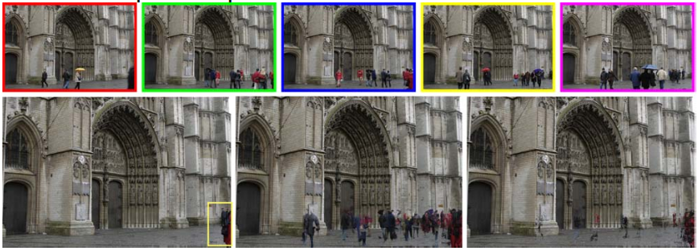
Max / min likelihood
Good for removing people in front of buildings.
Cost function given by: the probability of that pixel given by the distribution across that pixel’s span in RGB.

Slide 12
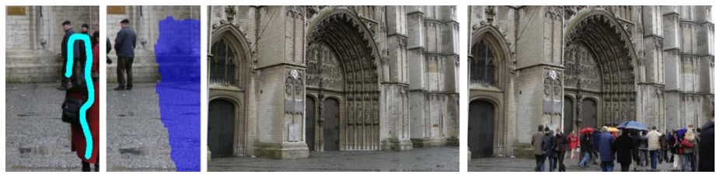
Eraser
The color most different from the current color (works like designated color, except for the color is designated by the current composite)
Cost function given by: Euclidean distance in RGB space

Slide 13
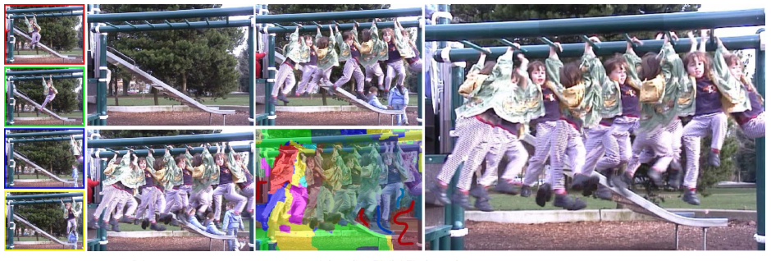
Max / min difference
The min or max difference between some specified source image at each pixel
Cost function given by: the Euclidea n distance in RGB space between the pixel in the specified source and the pixel’s span

Slide 14
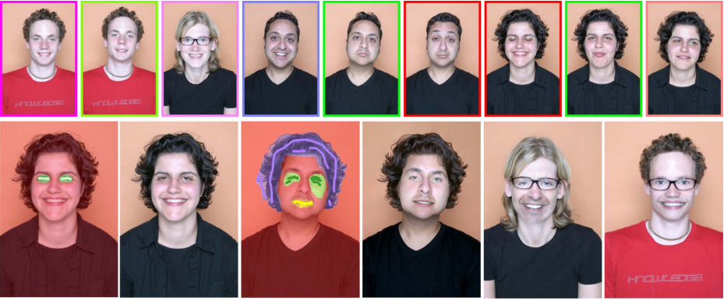
Designated image
For each stroke the user specifies which source image the pixels are to come from

Slide 15
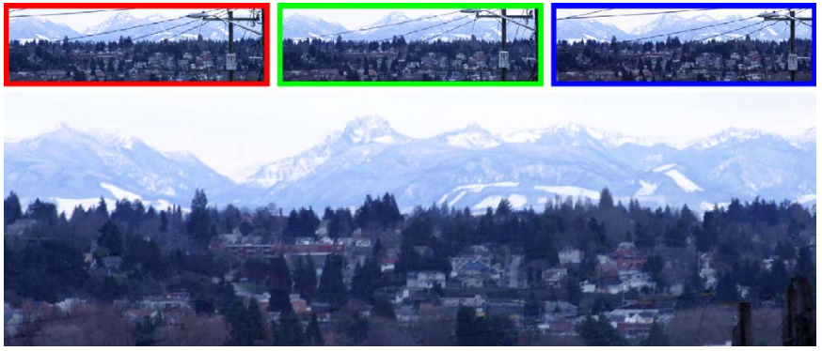
Max / min contrast
Min: Remove small sharp obstructions (wires)
Max: Good for increased depth of field (ant)
Cost function given by: Min/Max of a difference of Gaussians for each pixel’s span

Slide 16
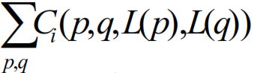
~ seam objective ~
Colors (Faces)
Colors & Gradients (Automatic/Global approaches)
Colors & Edges (Multiple versions of the same scene)

Slide 17
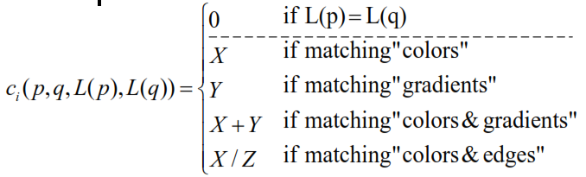
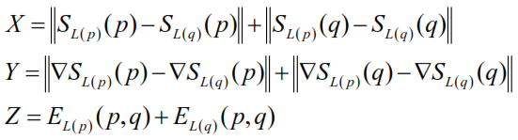


Slide 18
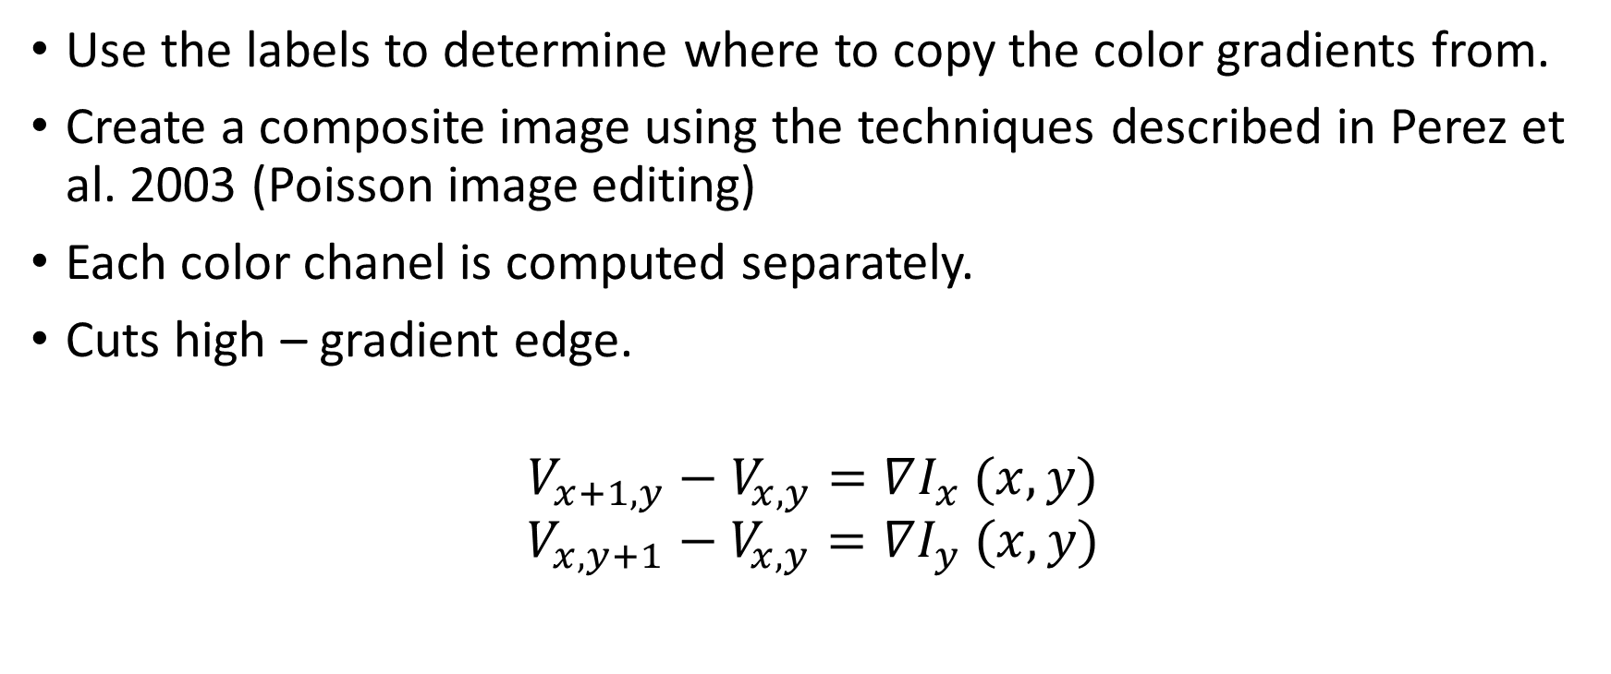
Gradient – domain fusion (blending)
Use the labels to determine where to copy the color gradients from.
Create a composite image using the techniques described in Perez et al. 2003 (Poisson image editing)
Each color chanel is computed separately.
Cuts high – gradient edge.
$$V_{x+1,y}−V_{x,y}=∇I_{x} (x,y)$$
$$V_{x,y+1}−V_{x,y}=∇I_{y} (x,y)$$

Slide 19
Thank you

